Slide 1
Async Programming using Vert.x
#highly concurrent #thread safe #asynchronous #reactor #event driven #scalable #polyglot #embeddable #microservices #serverless
Concepts
Manikanta Gade

Slide 2
Problem!
Scaling the app to serve ever increasing user base
2.1 billion smart phones in 2016 vs 3.15 billion by 2019 ¹
>21 billion IoT devices by 2020 ²
Raise in the user experience bar
Real time updates
Near instant results
Google: 100 milliseconds of latency can result in 1% of potential sales lost ³
Amazon: 1 sec extra delay in response costs $1.6 billion ⁴
Solution???
#1 emarketer.com report #2 Gartner report #3 Google #3 Amazon

Slide 3
Solution #1: Sync model
Request
DB query
Creating more threads (ex: Thread pool of 200)
Each thread manages one request
Ex: 200 Tomcat connector threads will serve 200 concurrent requests
Thread context switching is a hell (OS & CPU level)
Increased memory footprint
Each JVM thread roughly needs 2MB extra memory
More & more sync locks
Concurrency is very hard
Easy to debug & reason with
Blocked
Process data
HTTP call
Blocked
Response

Slide 4
Solution #2: Async model
Request #1
#1 DB query
Few threads do the entire job
Few threads = less thread context switching overhead
Few threads can handle lakhs of requests
No thread should be blocked for major time
Less memory footprint
Concurrency is very easy
Comparatively not easy to debug & reason with
Code can be come more complex if care is not taken
Request #2
#1 Process data
#2 DB query
#1 HTTP call
#2 Process data
#2 Response
#1 Response

Slide 5
What is ‘blocking’?
?

Slide 6
‘blocking’ is…
Application thread is not doing anything useful as it is waiting for data/action from other part of the system
Network operations
HTTP call, DB query, sending mails, …
Filesystem access
Reading a file…
OS requests (sync calls)
Allocate me some memory…
App will become unresponsive when all of your app threads blocked on something… basically we are screwed ☹
With increased usage, this happens more often than you would think
trust me on this!

Slide 7
am I ‘blocking’?
So… is doing a long running computation a blocking?
Performing complex math on huge data
Number crunching, etc…
As long as app threads are doing something meaningful, it is NOT blocking
NO!

Slide 8
When to use non-blocking?
Real time apps
Twitter, Stock feeds
Long lived connections
Instant messaging
Google chat, WhatsApp
Need to handle millions of client requests
list goes on…
When non-blocking many not be better?
Better stick with synchronous programming if all we are doing is complex math, number crunching which keeps the app threads busy
In that case anyway creating multiple threads is also not a better idea

Slide 9
Vert.x is…
A tool-kit for building reactive applications on the JVM
Collection of libraries which can stich parts of these libraries as required
Can be run as stand-alone or embedded (ex: servlet container)
Netty based event driven & Non-blocking
Yes, Node.js in Java ☺
Highly concurrent apps, with minimal Kernel threads
Polyglot
can use multiple languages including Java, JavaScript, Groovy, Ruby, Ceylon, Scala and Kotlin
Modular
Not a application container (like Tomcat)
Vertx-core, vertx-web, vertx-jdbc-client, vertx-redis-client, …
Quick to start & Low overhead
Not a full blown framework, but a collection of many libraries
not a application container (like Tomcat)
not the only tool
Akka, Rapidoid, Micronaut & may other…

Slide 10
Vert.x has (batteries included)…
Data access
JDBC, MongoDB, Redis, …
Reactive
RxJava 1, RxJava 2, Reactive Streams, Fibers*, Kotilin coroutines
Microservices
vertx-service-discovery, vertx-circuit-breaker
Integration
Kafka, STOMP, RabbitMQ, AMQP, MQTT, Consul, …
Auth
OAuth2, Apache Shiro, JDBC, JWT, …
Clustering
Apache Zookeeper, Hazelcast, Infinispan, Apache Ignite
Services
Service Proxies, SockJS Service Proxies, gRPC, Maven Service Factory, HTTP Service Factory
Dev-ops
Metrics (Dropwizard or Micrometer), health checks
Unit testing out of box

Slide 11
Vert.x core concepts
vertx instance
usually one instance is enough
Verticle (aka Event loop)
Where the actual work gets done
Handlers get executed synchronously on same thread
Event Bus
Verticles talk to each other using event bus
Distributed across cluster
Vertx-core has it all…
TCP/UDP servers & clients
HTTP/1.1, HTTP/2 servers & clients
SSL support
Websocket, Sock.js
Distributed Event Bus
Async filesystem access
Shared data (Map, Set)

Slide 12
Vert.x programming model
Event based
Event handlers (aka Callbacks), Futures, …
Few number of threads (aka Event loop)
Verticle is just fancy name for Event loop thread
Each Verticle executed on separate and same thread
Verticles communicate using Message passing via Event bus
Point to point, Publish/subscribe
Same Event bus work in cluster in clustered deployment
3 types of Verticles
Standard – Runs on Event loop thread, commonly used
Worker – Run on a separate thread from Vert.x worker thread, used to run blocking code
Multi-threaded worker – same as Worker, but runs on multiple threads instead of 1
All blocking operations will be executed on blocking executor pool
Ex: JDBC spec itself is blocking API – can’t do much about that, yet!
Don’t block Event loop for more time… never ever… You have been warned!
The lesser this time, the better resource utilization
Vert.x helps in tracking these Event loop blockings

Slide 13
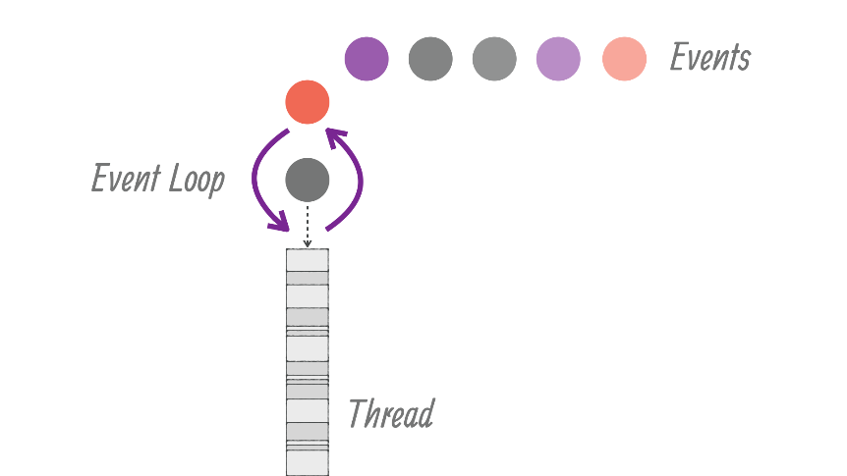
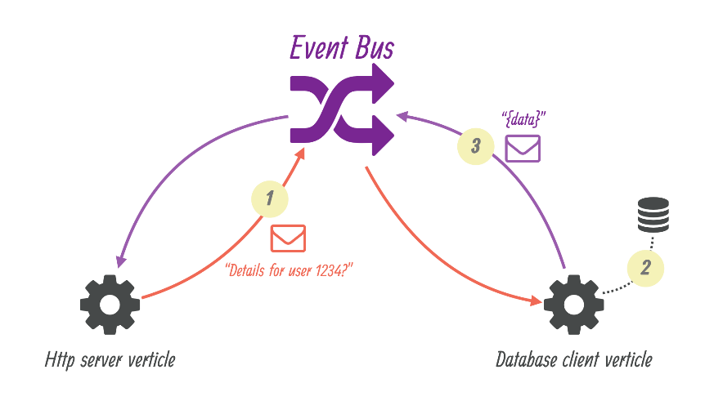
Vert.x flow…
Verticle 1
Verticle 2
Verticle 3
Verticle 4
Verticle 5
vertx 1
vertx 2
vertx 3
vertx 4
vertx 5
Event Bus (Local)
Event Bus (Clustered)
vertx instance
Cluster (ZooKeeper)

Slide 14
Async model – Current pain points
Comparatively little more complex to code & to reason with
This can be avoided using Lambdas, atomic & small methods
Little difficult to debug
Stack traces doesn’t always start with our code, but with Event loop
No Thread Locals…
this is actually a good thing – Java core developer’s agreed on this!
Upcoming Fiber’s won’t support this
This leads to difficulty in shared state, like Log MDC, Tenant context
Need to pass these to each method
Good news: Vert.x 3.6 has tracing support which will solve this
Did I hear Zipkin?

Slide 15
Async model – Future!
Looks great with Fiber’s (upcoming)
Existing code suddenly becomes Asynchronous (may be with little code changes)
Flow stays synchronous
= CPU is happy, Developers are happy, Customers are happy ☺
Asynchronous Database Access API (ADBA) spec (upcoming)

Slide 16
Start here…
https://vertx.io/
https://vertx.io/docs/guide-for-java-devs/
https://vertx.io/docs/vertx-core/java/

Slide 17
Thanks!
https://manikanta.com

